Slide 1
3.2.2- Practical Experiences
Factors that influence society’s relationships with OE, in action!
‘Chasing birds’ documentary (Friday 17th May) - commercialisation of an activity - unique portrayal (documentary)
VCE OES twitch’a’thon (Wednesday 22nd May) - portrayal (change your relationship with the environment through involvement in an activity you may not have considered)
Labertouche caves- expedition (Friday 24th May) - technology changing how we participate in an activity - society responding to people wanting to experience/participate in risk taking activities

Slide 2
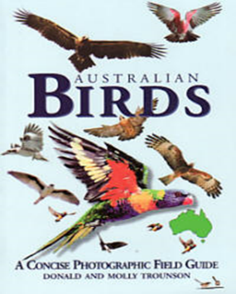
Why look at birds?
Birds are the most beautiful and accessible animals on earth. Birds are literally everywhere, and if one appreciates nature, one cannot but appreciate birds. There is almost nowhere you cannot find birds!
There is a tremendous variety of birds. Worldwide there are 9730 different species. Birds exhibit a vast array of different behaviours, including many that humans can relate to. Many birds are sociable and exhibit a remarkable range of adaptive behaviours.
Bird-watching takes one to many of the most beautiful and wonderfully atmospheric places on earth. If you want to meet someone who has seen the country, and knows every hidden treasure - just find an obsessive twitcher.

Slide 3
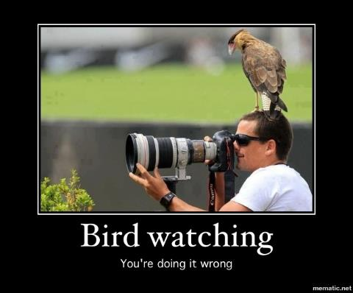
What exactly is Birdwatching?
It may be exactly that - watching birds. More generally, birdwatching is actually about observing and identifying the birds around us. Once one has noticed a bird and seen how it behaves the next question is: What is it? This is where birdwatching (as most people enjoy it) starts. The next step is a pair of binoculars to help get a better view of the birds you see, as well as a field-guide or reference book to help with identification.

Slide 4
What is the appeal of Birdwatching?
Birdwatching takes you to great places ! Once birding becomes more serious, it can involve a great deal of travelling and is an excellent excuse to see new parts of the planet. Many of the best places for birds are also scenically attractive and exciting to visit.
Birding is a challenge. The key challenge is to identify the birds you see, and to find and identify particular birds you want to see. Birding grows from being an interest to being a skill. The skill of finding and identifying birds involves knowledge about the habitat, habits plumage and shape of a bird. The more one gets to know about birds, the greater the degree to which one can judge size and shape from a distance, or pick up a fast moving bird quickly and notice the key features which tell you with certainty, what kind of duck, lorikeet, wren or warbler it is.
Birding is sociable. Contrary to some of the stereotypes about birders, most birders are highly sociable and spend a great deal of time discussion birding with other birders.

Slide 5
Keeping Lists (or ticking)
Once one had got into the fun and challenge of identifying birds, the next step is to keep some sort of record of what you have seen. This is where listing starts, and for most birders the most important list is a lifelist - a list of all the birds seen in one’s lifetime. However, listing is far more than just about a lifelist, it is a way of keeping track of observations, or of organising a vast number of experiences and ensuring that they are not lost. Listing is given particular meaning and value when it is part of an organised "scientific" effort to gather information.
A comprehensive example of these lists can be found at: http://www.eremaea.com
There are now hundreds of apps that help with bird watching- whether it be keeping track of an individual session, what you’ve managed to see at a specific venue over time, or managing your life list (every species you’ve ever seen).

Slide 6
Twitching
Once one has got into building up a life list, you then become a twitcher. A twitcher is someone who actively seeks out new birds to put on their lifelist and the word is supposed to describe the uncontrollable spasms of excitement when seeing a new bird for the first time. Most birders are twitchers to some extent, but the degree to which the ticking of new species is important is a personal thing. Some birders can be described as "hard-core" twitchers, and are interested in nothing other than ticking new species.
Most birders still enjoy seeing birds they have already seen. Birdwatching that is not oriented towards “twitching” (not about new species) is usually more leisurely, unless when it becomes power-birding. Both power-birding and twitching have leant themselves to the use of a whole range of techniques for finding birds. One of these is the use of tape-recorded calls. Birders need to remember that birds are wild animals and disturbance should be kept to a minimum. Familiarity with a code of conduct for birders is a good idea.

Slide 7
